Slide 1

David M. Kroenke and David J. Auer Database Processing: Fundamentals, Design, and Implementation
Chapter Two:
Introduction to Structured Query Language
Part 1: Single Table Queries

Slide 2
Chapter Objectives
To understand the use of extracted data sets in business intelligence (BI) systems
To understand the use of ad-hoc queries in business intelligence (BI) systems
To understand the history and significance of Structured Query Language (SQL)
To understand the SQL SELECT/FROM/WHERE framework as the basis for database queries
To create SQL queries to retrieve data from a single table

Slide 3
Chapter Objectives
To create SQL queries that use the SQL SELECT, FROM, WHERE, ORDER BY, GROUP BY, and HAVING clauses
To create SQL queries that use the SQL DISTINCT, TOP, and TOP PERCENT keywords
To create SQL queries that use the SQL comparison operators including BETWEEN, LIKE, IN, and IS NULL
To create SQL queries that use the SQL logical operators including AND, OR, and NOT

Slide 4
Chapter Objectives
To create SQL queries that use the SQL built-in functions of SUM, COUNT, MIN, MAX, and AVG with and without the use of a GROUP BY clause
To create SQL queries that retrieve data from a single table but restrict the data based upon data in another table (subquery)
To create SQL queries that retrieve data from multiple tables using the SQL join and JOIN ON operations
To create SQL queries that retrieve data from multiple tables using the SQL OUTER JOIN operation

Slide 5
Chapter Objectives
To create SQL queries that retrieve data from multiple tables using SQL set operators UNION, INTERSECT, and EXCEPT

Slide 6
Coverage
This Microsoft PowerPoint Slide Show covers single table queries and the first ten chapter objectives

Slide 7
Business Intelligence (BI) Systems
Business intelligence (BI) systems are information systems that assist managers and other professionals:
Assessment
Analysis
Planning
Control

Slide 8
Ad-Hoc Queries
Ad-hoc queries:
Questions that can be answered using database data
Example: “How many customers in Portland, Oregon, bought our green baseball cap?”
Created by the user as needed, instead of programmed into an application
Common in business

Slide 9
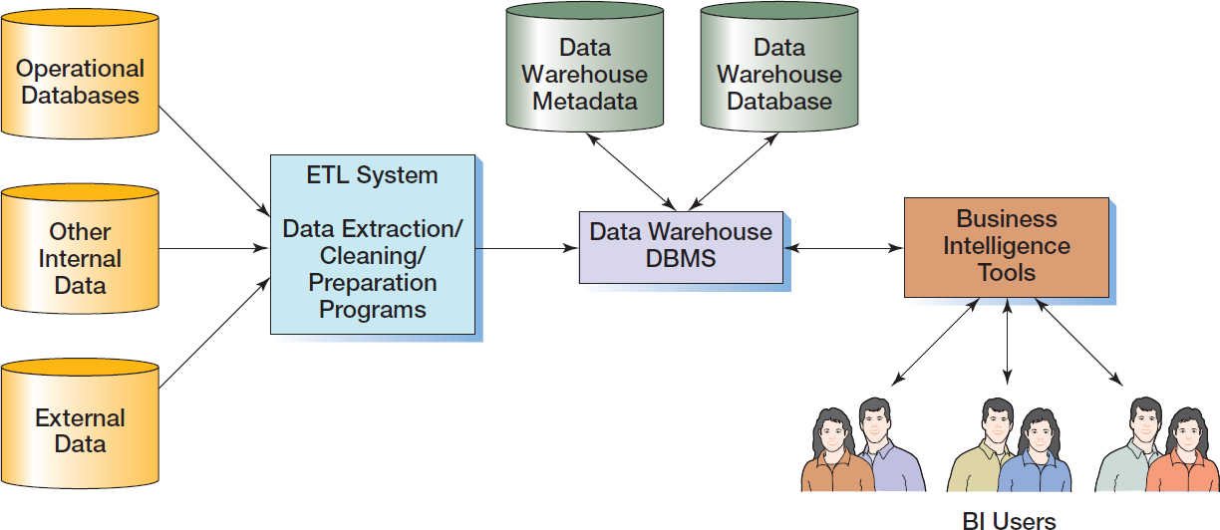
Components of a Data Warehouse
Notes:
BI systems typically store their associated data in data warehouses, which are database systems that have data, programs, and personnel that specialize in the preparation of data for BI processing. Data warehouses will be iscussed in detail in Chapter 12, so for now we will simply note that data warehouses vary in scale and scope. They can be as simple as a sole employee processing a data extract on a part-time basis or as complex as a department with dozens of employees maintaining libraries of data and programs.
The components of a typical company-wide data warehouse. Data are read from operational databases (the databases that store the company’s current day-to-day transaction data), from other internal data, or from external data sources by the Extract, Transform, and Load (ETL) system. The ETL system then cleans and prepares the data for BI processing.
This can be a complex process, but the data is then stored in the data warehouse DBMS for use by BI users who access the data by various BI tools. The DBMS used for the data warehouse stores both databases and the metadata for those databases.
A small, specialized data warehouse is referred to as a data mart. Data marts and their relationship to data warehouses are discussed in Chapter 12. Note that the DBMS used for the data warehouse may or may not be the same DBMS product used for the operational databases.

Slide 10
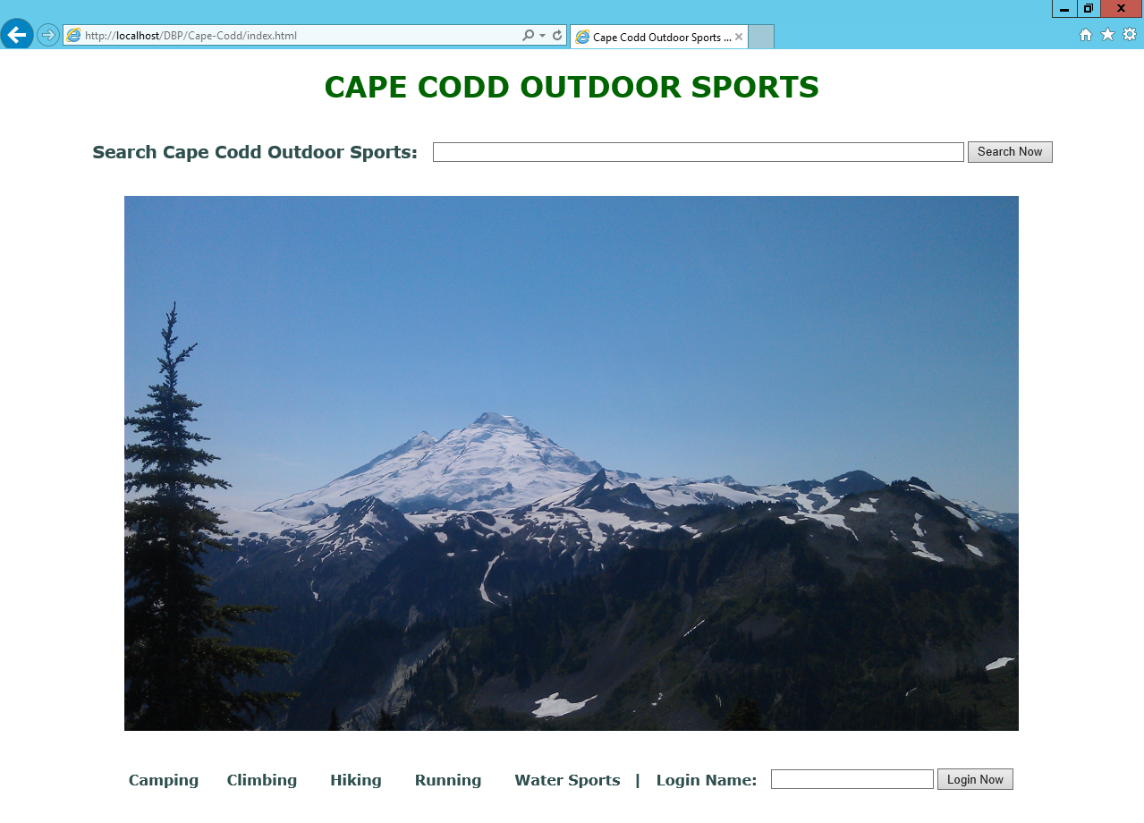
Cape Codd Outdoor Sports
Notes:
For our work in this chapter, we will use data from Cape Codd Outdoor Sports (although based on a real outdoor retail equipment vendor, Cape Codd Outdoor Sports is a fictitious company). The Cape Codd Outdoor Sports Web site is shown here.

Slide 11
Cape Codd Outdoor Sports
Cape Codd Outdoor Sports is a fictitious company based on an actual outdoor retail equipment vendor.
Cape Codd Outdoor Sports:
Has 15 retail stores in the United States and Canada.
Has an online Internet store.
Has a (postal) mail order department.
All retail sales are recorded in an Oracle Database 12c database.

Slide 12
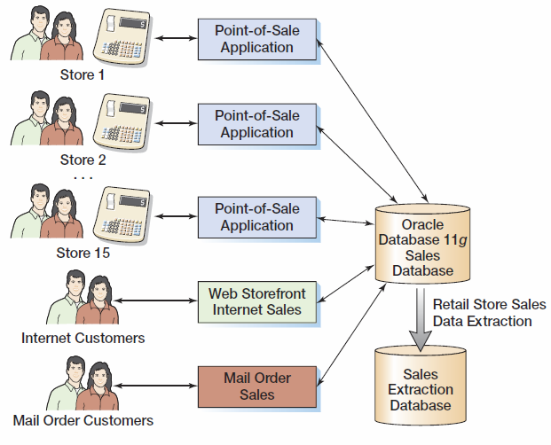
Cape Codd Retail Sales Structure

Slide 13
Cape Codd Outdoor Sports Retail Sales and Catalog Context Data Extraction I
The Cape Codd marketing department needs an analysis of:
In-store sales.
Catalog content.
The entire database is not needed for this, only an extraction of retail sales data and catalog content.
The data is extracted by the IS department from the operational database into a separate, off-line database for use by the marketing department.

Slide 14
Cape Codd Outdoor Sports Retail Sales and Catalog Context Data Extraction II
Five tables are used: RETAIL_ORDER, ORDER_ITEM, SKU_DATA (SKU = Stock Keeping Unit), CATALOG_SKU_2014, and CATALOG_SKU_2015
The extracted data is converted as necessary:
Into a different DBMS—Microsoft SQL Server
Into different columns—OrderDate becomes OrderMonth and OrderYear.

Slide 15
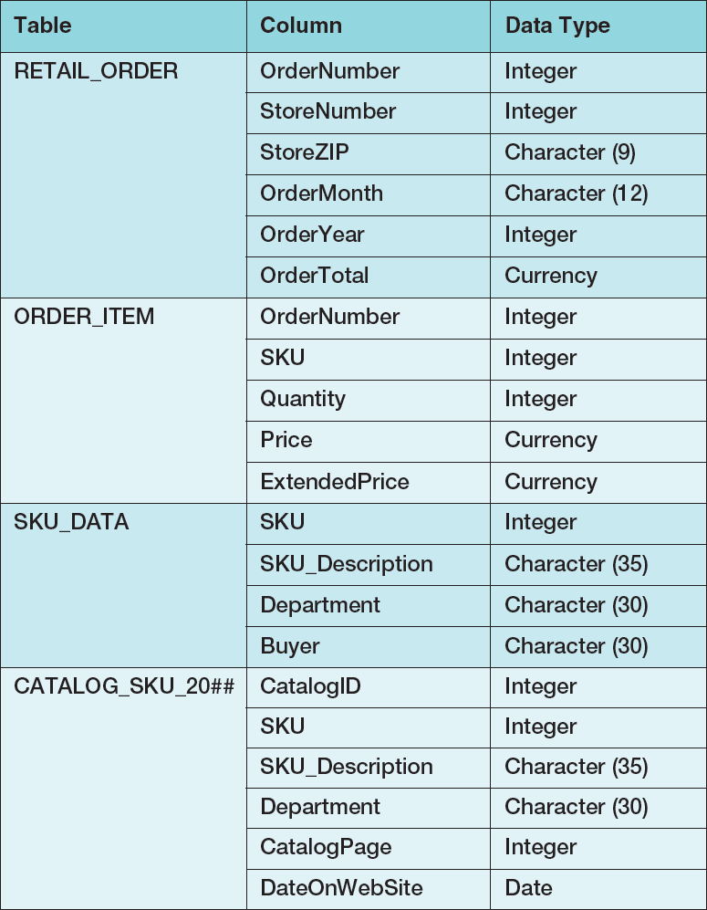
Extracted Data Format

Slide 16
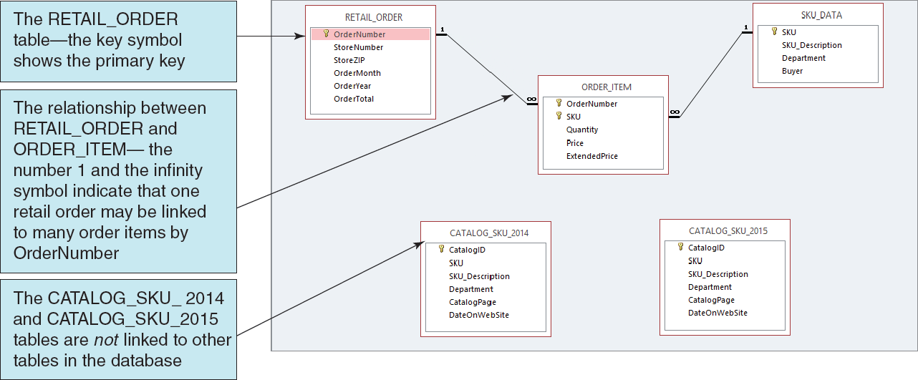
Extracted Data Tables I [in Microsoft Access 2013]

Slide 17
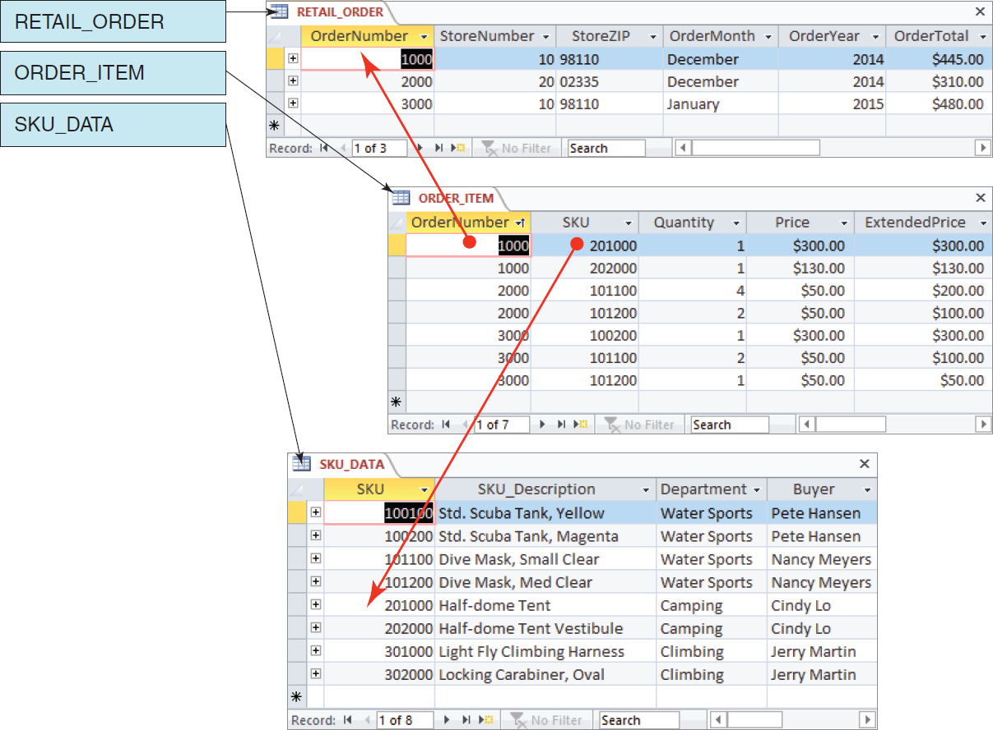
Extracted Tables II [in Microsoft Access 2013]

Slide 18
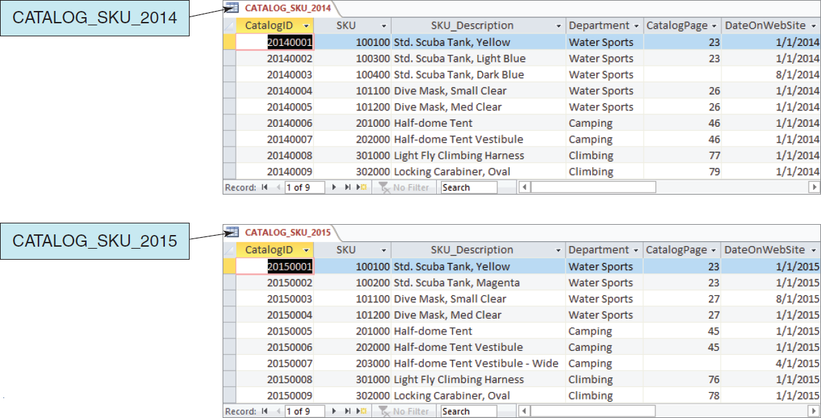
Extracted Tables III [in Microsoft Access 2013]

Slide 19
Cape Codd Database Available Online I
Versions of the complete Cape Codd database are available in the downloadable Student Files available at:
http://www.pearsonhighered.com/kroenke/
These include versions for:
Microsoft Access 2013
Microsoft SQL Server 2014
Oracle Database 12c and Oracle Database XE
MySQL 5.6
We recommend you actually run all material in a live database!

Slide 20
Cape Codd Database Available Online II
To complete setting up the Cape Codd database, set the referenced materials:
For Microsoft Access 2013:
The database *.accdb is ready for immediate use
For Microsoft SQL Server 2014:
See Online Chapter 10A
For Oracle Database 12c and Oracle Database XE:
See Online Chapter 10B
For MySQL 5.6
See Online Chapter 10C
Online chapters 10A, 10B, and 10C are available for download at:
http://www.pearsonhighered.com/kroenke/

Slide 21
Structured Query Language
Structured Query Language (SQL) was developed by the IBM Corporation in the late 1970’s.
SQL was endorsed as a U.S. national standard by the American National Standards Institute (ANSI) in 1992 [SQL-92].
Newer versions exist, such as SQL:2008 and SQL:2011,and they incorporate new features including XML and some object-oriented concepts. Some of these features are discussed in this book.

Slide 22
SQL As a Data Sublanguage
SQL is not a full featured programming language.
C, C#, Java
SQL is a data sublanguage for creating and processing database data and metadata.
SQL is ubiquitous in enterprise-class DBMS products.
SQL programming is a critical skill.

Slide 23
SQL Categories
SQL statements can be divided into five categories:
Data definition language (DDL)
Data manipulation language (DML) statements
SQL/Persistent Stored Modules (SQL/PSM) statements
Transaction control language (TCL) statements
Data control language (DCL) statements

Slide 24
SQL DDL
Data definition language (DDL) statements
Used for creating tables, relationships, and other structures
Covered in Chapter 7

Slide 25
SQL DML
Data manipulation language (DML) statements
Used for:
Queries – SQL SELECT statement
Inserting data – SQL INSERT statement
Modifying data – SQL UPDATE statement
Deleting data – SQL DELETE statement
Covered in this chapter (Chapter 2)

Slide 26
SQL SQL/PSM
SQL/Persistent Stored Modules (SQL/PSM) statements
Add procedural programming capabilities
Variables
Control-of-flow statements
Covered in Chapters:
7 (general introduction)
10A (SQL Server 2014)
10B (Oracle Database)
10C (MySQL 5.6)

Slide 27
SQL TCL
Transaction control language (TCL) statements
Used to mark transaction boundaries and control transaction behavior
Covered in Chapters:
9 (general introduction)
10A (SQL Server 2014)
10B (Oracle Database)
10C (MySQL 5.6)

Slide 28
SQL DCL
Data control language (DCL) statements
Used to grant (or revoke) database permissions to (from) users and groups
Covered in Chapters:
9 (general introduction)
10A (SQL Server 2014)
10B (Oracle Database)
10C (MySQL 5.6)

Slide 29
CRUD
The four actions listed for SQL DML are sometimes referred to as CRUD:
Create [SQL equivalent is INSERT]
Read [SQL equivalent is SELECT]
Update [SQL equivalent is UPDATE]
Delete [SQL equivalent is DELETE]
We do not use this term in this book, but now you know what it means.

Slide 30
The SQL SELECT Statement
The fundamental framework for an SQL query is the SQL SELECT statement.
SELECT {ColumnName(s)}
FROM {TableName(s)}
WHERE {Condition(s)}
All SQL statements end with a semi-colon (;).

Slide 31
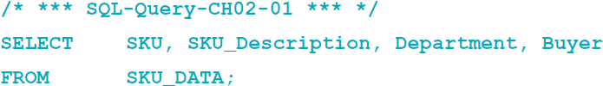
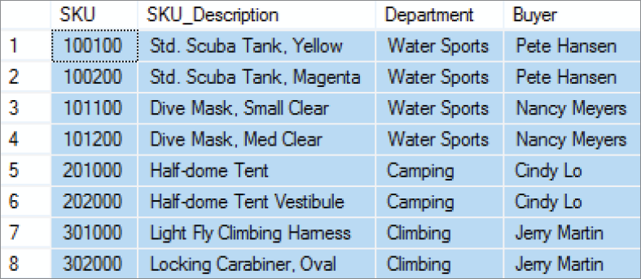
Specific Columns on One Table

Slide 32
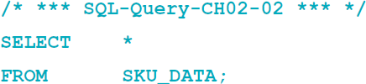
Selecting All Columns: The SQL Asterisk (*) Wildcard Character

Slide 33
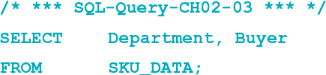
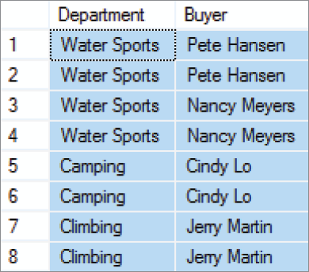
Specifying Column Order I

Slide 34
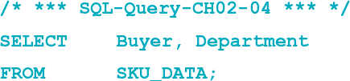
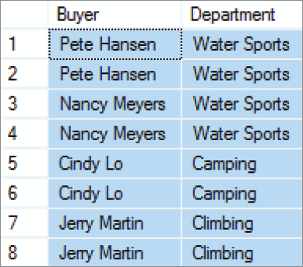
Specifying Column Order II

Slide 35
Note: Extra Tables Shown
The following discussions of running SQL queries in Microsoft Access 2013, Microsoft SQL Server 2014, Oracle Database and MySQL 5.6 show three extra Cape Codd database tables:
CATALOG_SKU_2013
INVENTORY
WAREHOUSE
These tables are used in the end of chapter questions.

Slide 36
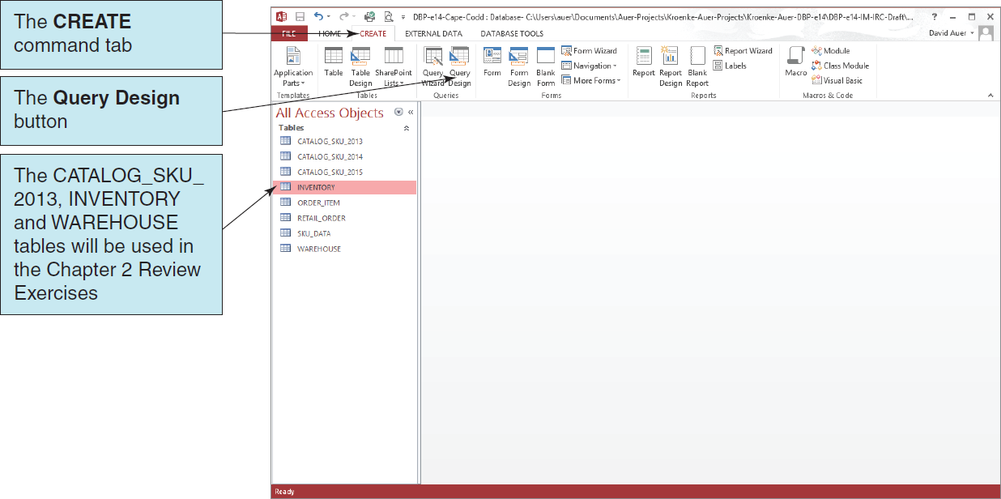
Using Microsoft Access 2013 I

Slide 37
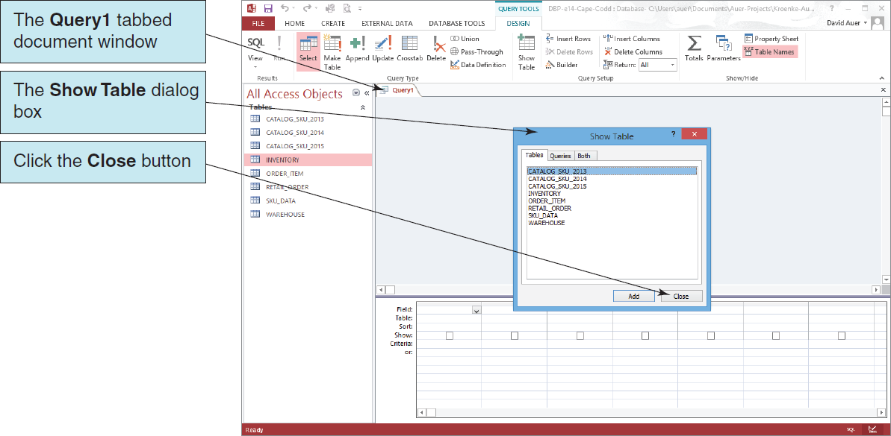
Using Microsoft Access 2013 II

Slide 38
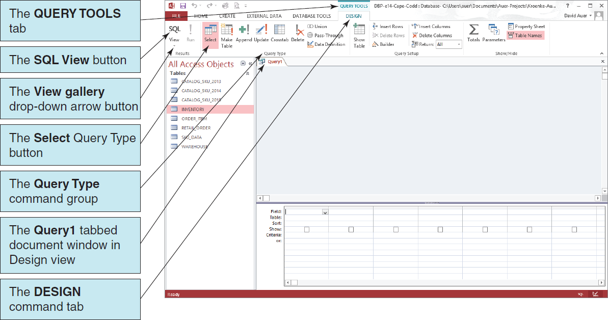
Using Microsoft Access 2013 III

Slide 39
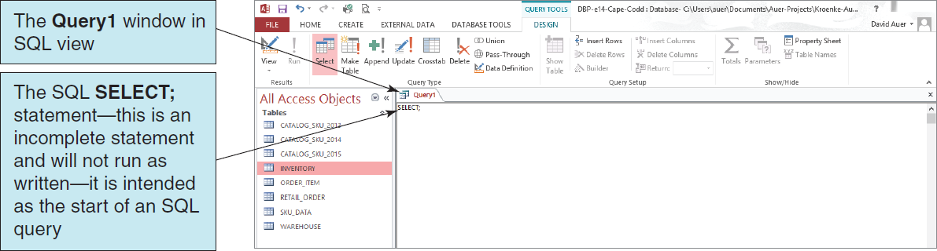
Using Microsoft Access 2013 IV

Slide 40
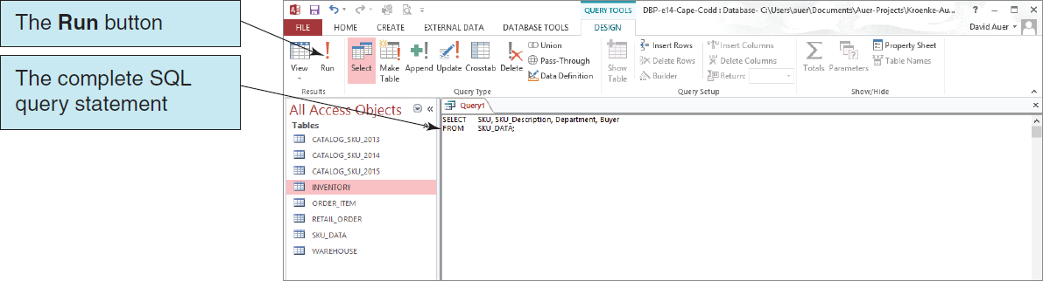
Using Microsoft Access 2013 V

Slide 41
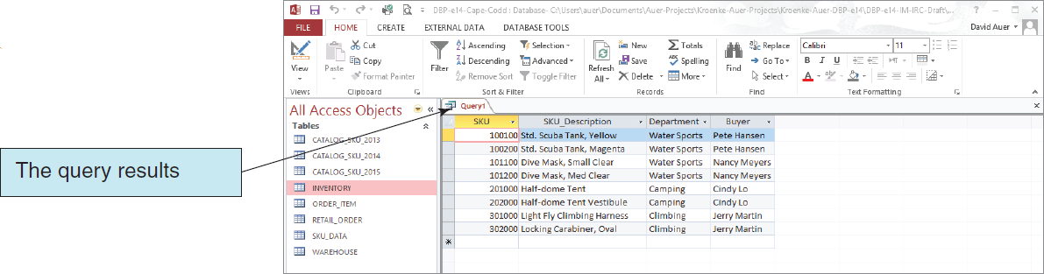
Using Microsoft Access 2013 VI The Query Results

Slide 42
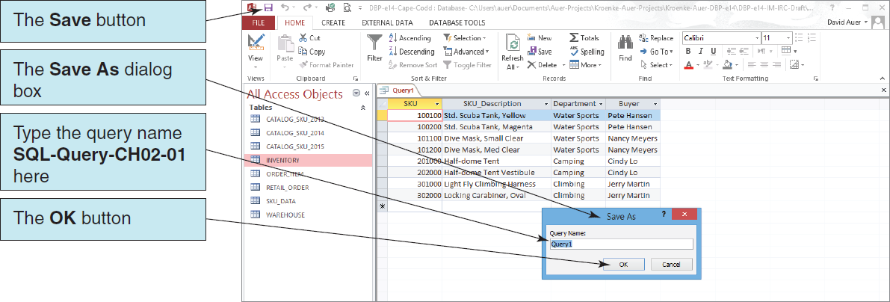
Using Microsoft Access 2013 VII Saving the Query

Slide 43
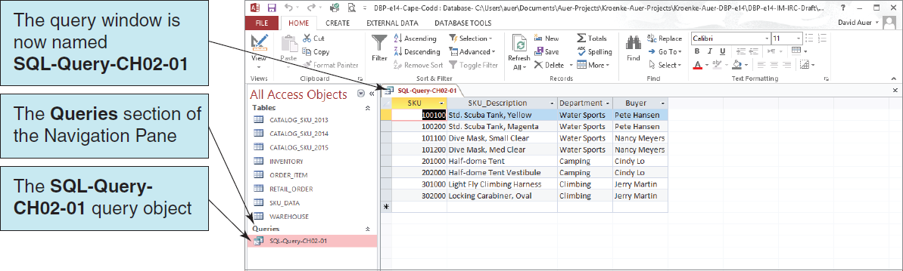
Using Microsoft Access 2013 VII The Named and Saved Query

Slide 44
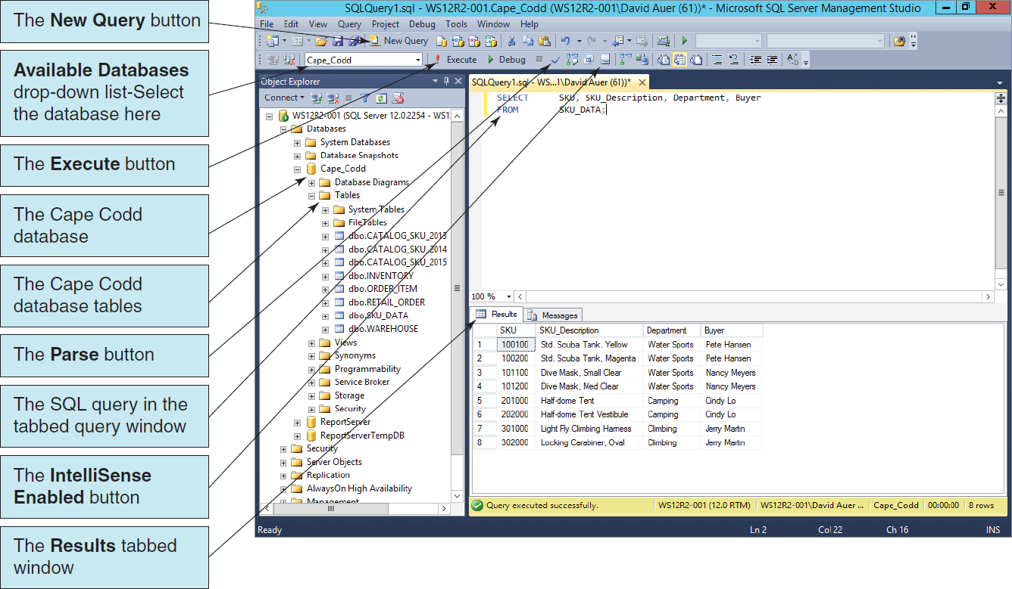
Using Microsoft SQL Server 2014 I The Microsoft SQL Server Management Studio

Slide 45
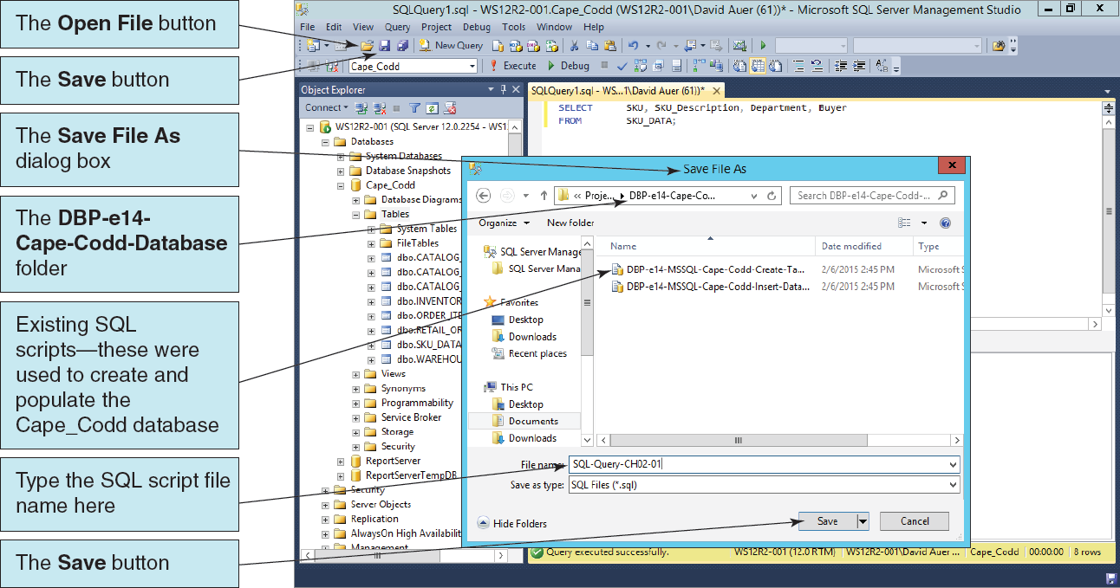
Using Microsoft SQL Server 2014 II Saving a Microsoft SQL Server 2014 Query

Slide 46
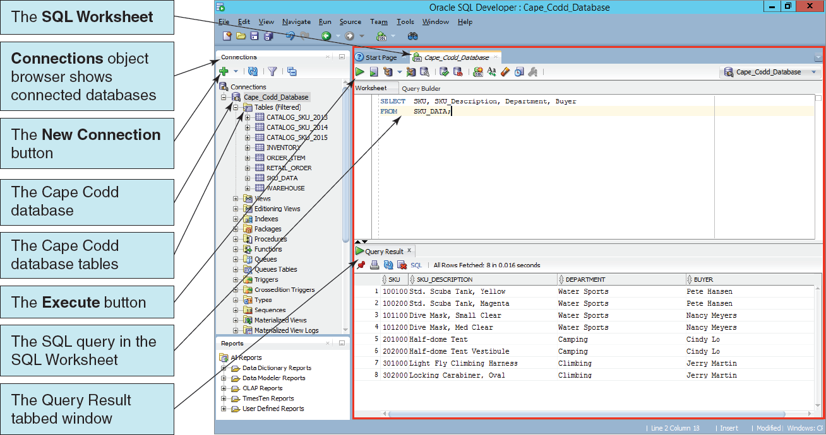
Using Oracle Database I Oracle SQL Developer

Slide 47
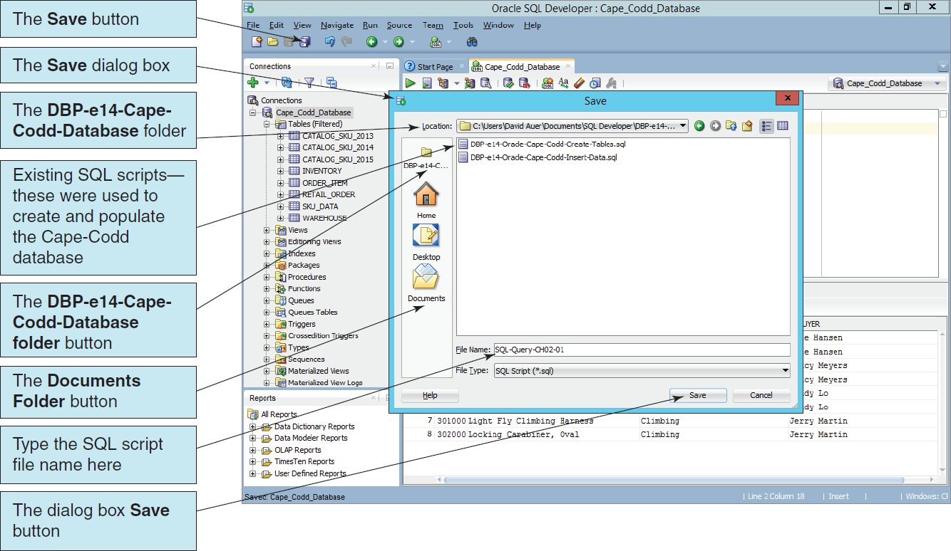
Using Oracle Database II Saving an Oracle Database SQL Query

Slide 48
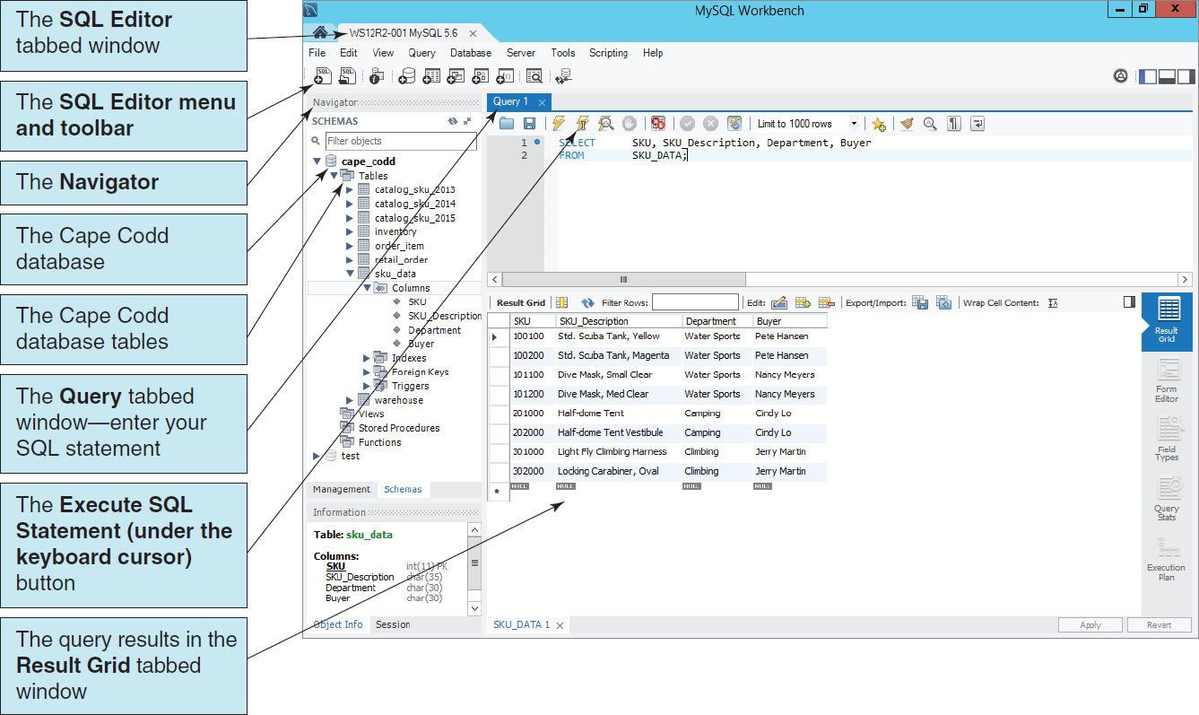
Using MySQL 5.6 I MySQL Workbench

Slide 49
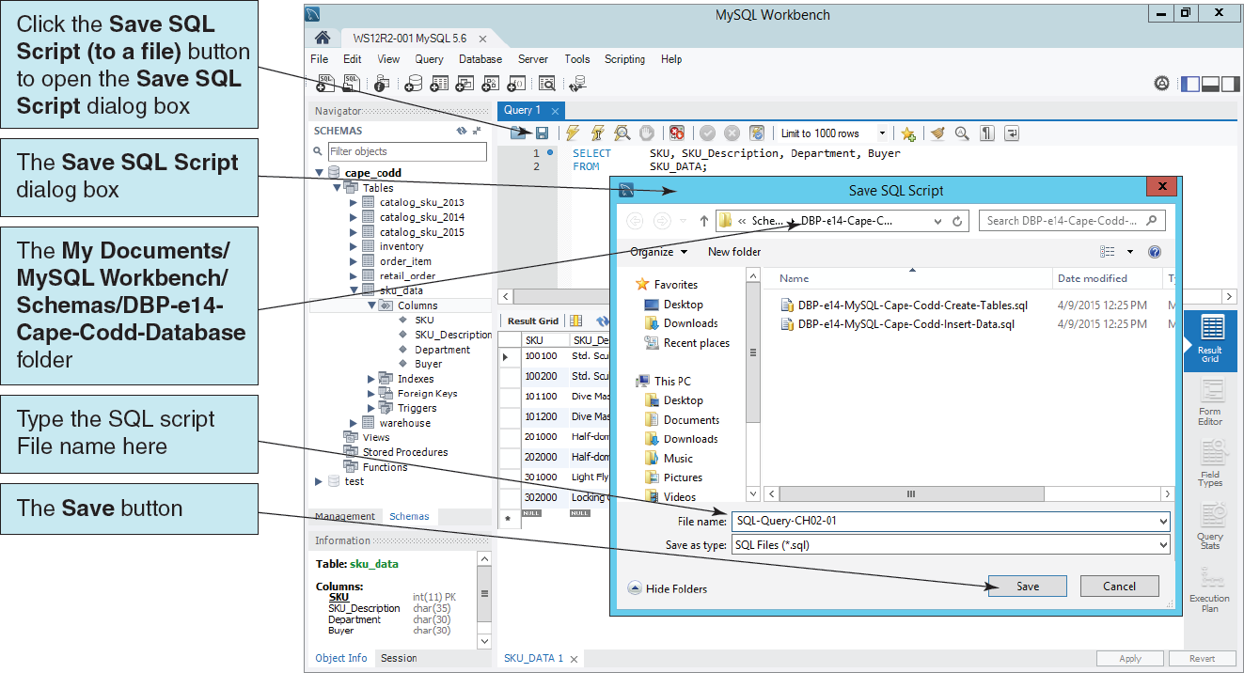
Using MySQL 5.6 II Saving a MySQL 5.6 Query

Slide 50
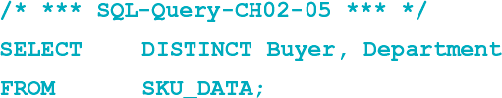
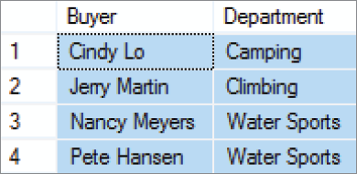
Reading Specified Rows from a Single Table The SQL DISTINCT Keyword

Slide 51
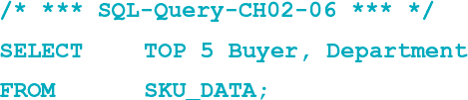
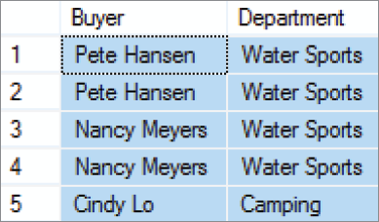
Reading Specified Rows from a Single Table The SQL TOP {NumberOfRows} Function
NOTE: This is an SQL Server specific function. See the Oracle Database and MySQL 5.6 documentation for the equivalent functionality in those DBMSs.

Slide 52

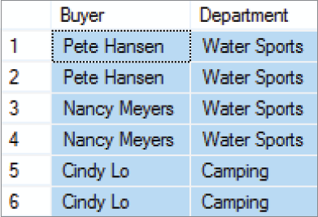
Reading Specified Rows from a Single Table The SQL TOP {Percentage} PERCENT Function
NOTE: This is an SQL Server specific function. See the Oracle Database and MySQL 5.6 documentation for the equivalent functionality in those DBMSs.

Slide 53
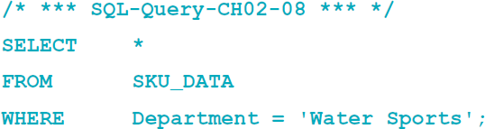
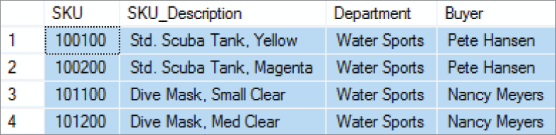
Reading Specified Rows from a Single Table The SQL WHERE Clause: Character Strings
NOTE: SQL wants a plain ASCII single quote: ' NOT ‘ !

Slide 54
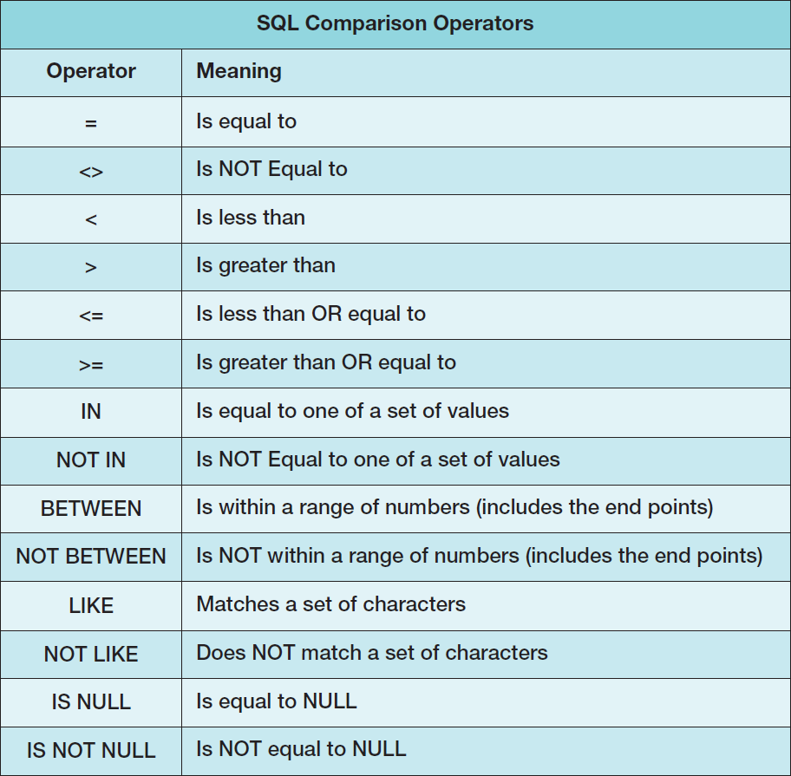
SQL Comparison Operators

Slide 55
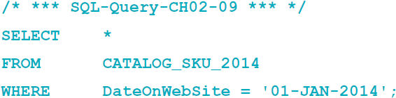
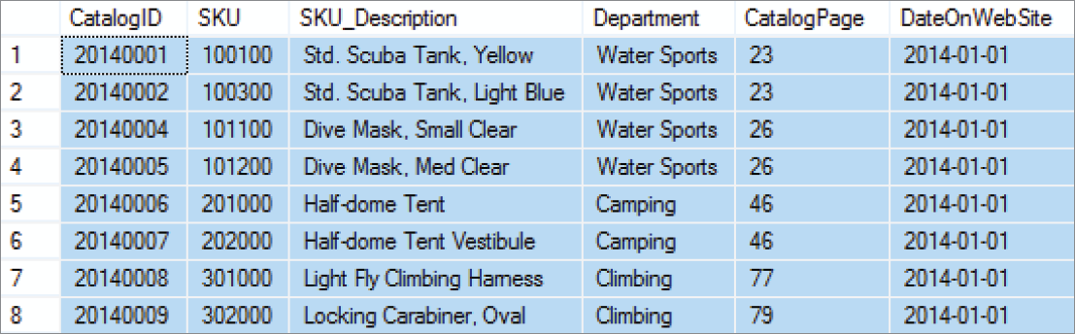
Reading Specified Rows from a Single Table The SQL WHERE Clause: Dates
NOTE: See Chapters 10B and 10C for a discussion of dates in Oracle Database and MySQL respectively.
NOTE: Microsoft Access 2013 dates must be enclosed within # symbols: #01/01/14#

Slide 56
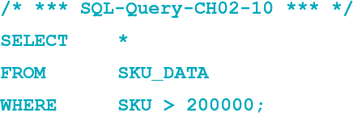
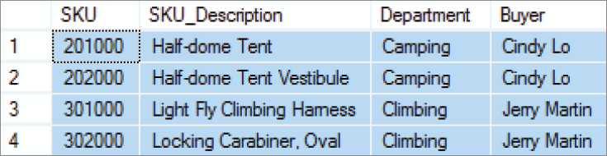
Reading Specified Rows from a Single Table The SQL WHERE Clause: Numbers

Slide 57
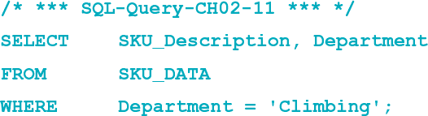
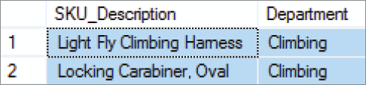
Reading Specified Columns and Rows from a Single Table Column Names and the SQL WHERE Clause
NOTE: A column used in the WHERE clause does not have to be one of the columns listed in the SELECT clause.

Slide 58
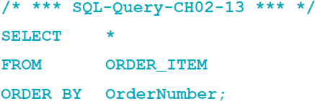
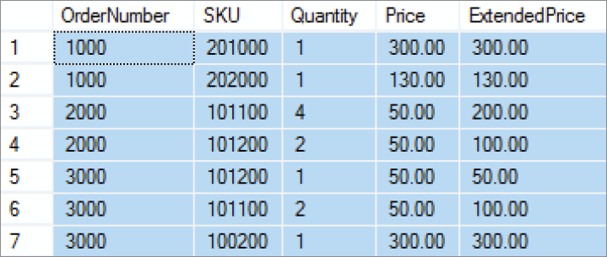
Sorting the SQL Query Results The SQL ORDER BY Clause

Slide 59
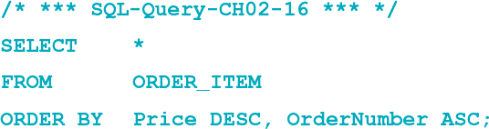
Sorting the SQL Query Results Ascending and Descending Sort Order
NOTE: The default sort order is ASC—it does not have to be specified.

Slide 60
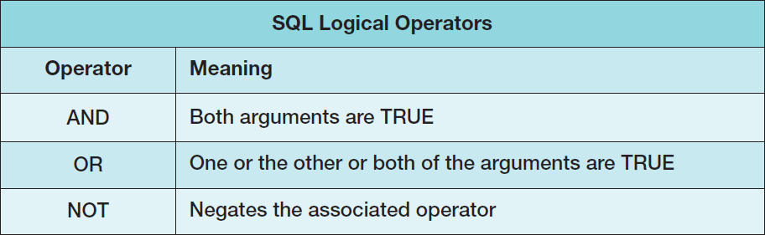
SQL WHERE Clause Options SQL Logical Operators

Slide 61
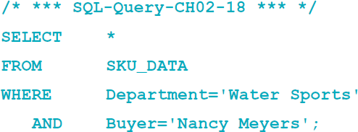
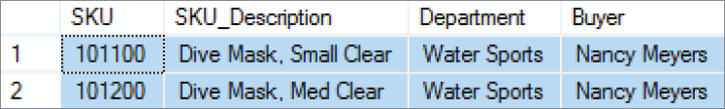
SQL WHERE Clause Options SQL AND Operator

Slide 62
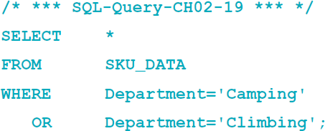
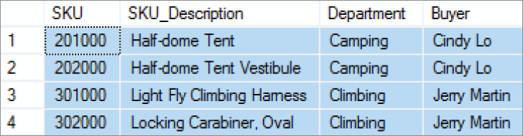
SQL WHERE Clause Options SQL OR Operator

Slide 63


SQL WHERE Clause Options SQL NOT Operator

Slide 64


SQL WHERE Clause Options Sets of Values: SQL IN Operator

Slide 65


SQL WHERE Clause Options Sets of Values: SQL NOT IN Operator
A row qualifies for an IN condition if the column is equal to any of the values in the parentheses.
A row qualifies for a NOT IN condition if it is not equal to all of the items in the parentheses.

Slide 66


SQL WHERE Clause Options Ranges of Values: Using Math Symbols

Slide 67

SQL WHERE Clause Options Ranges of Values: SQL BETWEEN Operator

Slide 68


SQL WHERE Clause Options Ranges of Values: SQL NOT BETWEEN Operator

Slide 69
SQL WHERE Clause Options Character String Patterns: SQL Wildcard Characters
The SQL LIKE operator and SQL NOT LIKE operator can be combined with wildcard symbols:
SQL 92 Standard (SQL Server, MySQL, etc.):
_ = exactly one character
% = any set of one or more characters
Microsoft Access (based on MS DOS)
? = exactly one character
* = any set of one or more characters

Slide 70


SQL WHERE Clause Options Character String Patterns: SQL LIKE Operator I

Slide 71


SQL WHERE Clause Options Character String Patterns: SQL LIKE Operator II

Slide 72


SQL WHERE Clause Options Character String Patterns: SQL LIKE Operator III

Slide 73

SQL WHERE Clause Options Using NULL Values: SQL IS NULL Operator

Slide 74


SQL WHERE Clause Options Using NULL Values: SQL IS NOT NULL Operator

Slide 75

Performing Calculations in SQL Queries SQL Built-in Aggregate Functions

Slide 76


Performing Calculations in SQL Queries Using SQL Built-in Aggregate Functions: SUM
We can assign meaningful column names using the SQL AS keyword.

Slide 77


Performing Calculations in SQL Queries Using SQL Built-in Aggregate Functions: SUM, AVG, MIN and MAX
We can assign meaningful column names using the SQL AS keyword.

Slide 78


Performing Calculations in SQL Queries Using SQL Built-in Aggregate Functions: COUNT(*)
We can assign meaningful column names using the SQL AS keyword.

Slide 79


Performing Calculations in SQL Queries Using SQL Built-in Aggregate Functions: COUNT({Name})
We can assign meaningful column names using the SQL AS keyword.
We use the SQL DISTINCT keyword to count each value only once.

Slide 80
Performing Calculations in SQL Queries SQL Expressions
An SQL expression is a formula or set of values that determines the exact results of an SQL query.
We can think of an SQL expression as anything that:
Follows an actual or implied is equal to (=) comparison operator (or any other comparison operator, such as greater than (>), less than (<), and so on)
Follows certain SQL comparison operator keywords, such as LIKE and BETWEEN.

Slide 81


Performing Calculations in SQL Queries Using SQL Expressions
We can assign meaningful column names using the SQL AS keyword.

Slide 82


Performing Calculations in SQL Queries Using SQL Expressions with String Functions: Concatenation I
This is the Microsoft SQL Server 2014 syntax:

Slide 83


Performing Calculations in SQL Queries Using SQL Expressions with String Functions: Concatenation II
This is the Oracle Database syntax:
This is the MySQL 5.6 syntax:

Slide 84


Performing Calculations in SQL Queries Using SQL Expressions with String Functions: RTRIM Function
This is the Microsoft SQL Server 2014 syntax:

Slide 85

Grouping Rows in SQL Queries Department Groups in the CATALOG_SKU_2014 Table

Slide 86

Grouping Rows in SQL Queries The Department Groups Summarized in Microsoft Excel 2013
Note that only 8 of the 9 items in the CATALOG_SKU_2014 actually appeared in the catalog itself ─ the other item was only on the Web site.

Slide 87


Grouping Rows in SQL Queries The SQL GROUP BY Clause

Slide 88


Grouping Rows in SQL Queries The SQL HAVING Clause
The SQL HAVING clause controls which groups are in the query result:

Slide 89
Grouping Rows in SQL Queries
The SQL WHERE clause specifies which rows will be used to determine the groups.
The SQL HAVING clause specifies which groups will be used in the final result.
In general, place WHERE before GROUP BY. Some DBMS products do not require that placement; but to be safe, always put WHERE before GROUP BY.
There is an ambiguity in statements that include both WHERE and HAVING clauses. The results can vary, so to eliminate this ambiguity SQL always applies WHERE before HAVING.

Slide 90


Grouping Rows in SQL Queries Grouping by More Than One Column

Slide 91


Grouping Rows in SQL Queries Column Names that Must Appear in GROUP BY
When using the GROUP BY clause, any and all column names in the SELECT clause that are not used by or associated with an SQL built-in function must appear in the GROUP BY clause! Otherwise, you will get an error message!
Note that in SQL-Query-CH02-51 SKU by itself and SKU in COUNT(SKU) are considered to be two different column names.

Slide 92


Grouping Rows in SQL Queries Using the SQL ORDER BY Clause with Groupings

Slide 93
David Kroenke and David Auer Database Processing Fundamentals, Design, and Implementation (14th Edition)
End of Presentation:
Chapter Two Part One

Slide 94

All rights reserved. No part of this publication may be reproduced, stored in a retrieval system, or transmitted, in any form or by any means, electronic, mechanical, photocopying, recording, or otherwise, without the prior written permission of the publisher. Printed in the United States of America.

